Slide 1
Capstone Design
Team 3
20163704
20161344
20164245
Park JuHyeon
Heo JeongWoo
Hong Jin

Slide 2
Contents
1.
Feedback
Model
Schedule
Q&A
2.
3.
4.

Slide 3
1.
Q&A Feedback

Slide 4
1
Q&A Feedback
Feedback
Idea vs Model

Slide 5

1
Q&A Feedback
Consultation Result
It’s difficult to make a learning model.
So how about add ideas??

Slide 6
2.
Progress

Slide 7
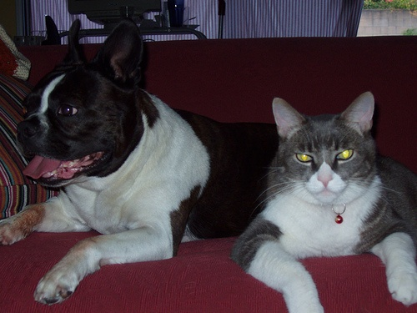

2
Progress
Modify Topic
Previous Topic : Lasso with some points

Slide 8


2
Progress
Modify Topic
Model
person
Input
Output

Slide 9

2
Progress
Scenario
file
Main
Sub

Slide 10
2
Progress
Scenario
file
Open File
Main
Sub

Slide 11
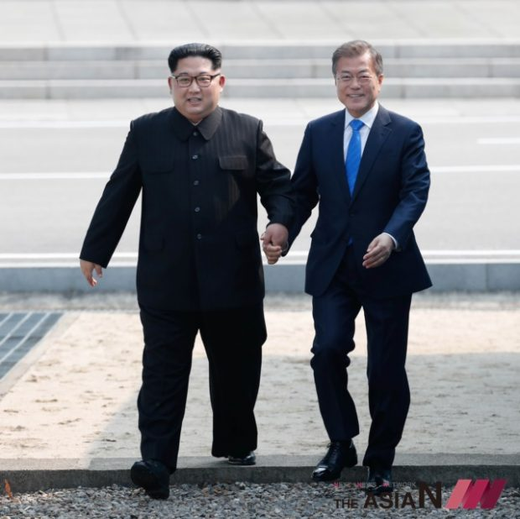
2
Progress
Scenario
file
example 1
example 2
Main
Sub

Slide 12

2
Progress
Scenario
file
example 1
example 2
Main
Sub

Slide 13
2
Progress
Scenario
file
example 1
example 2
Main
Sub

Slide 14
2
Progress
Scenario
file
example 1
example 2
Insert keyword
Main
Sub

Slide 15
2
Progress
Scenario
file
example 1
example 2
Insert keyword
person
Main
Sub

Slide 16


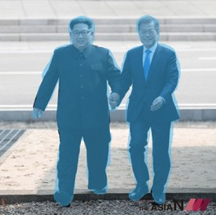
2
Progress
Scenario
file
example 1
example 2
person
Main
Sub

Slide 17
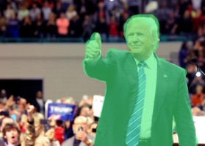
2
Progress
Scenario
file
example 1
example 2
person
Main
Sub

Slide 18

2
Progress
Scenario
file
example 1
example 2
person
drag
Main
Sub

Slide 19
2
Progress
Scenario
file
example 1
example 2
person
Main
Sub

Slide 20
2
Progress
Learning Model
Detection + Segmentation
Classification is very important!
Searching appropriate model

Slide 21
2
Progress
Learning Model
Goal
Accuracy
Many classification criteria

Slide 22
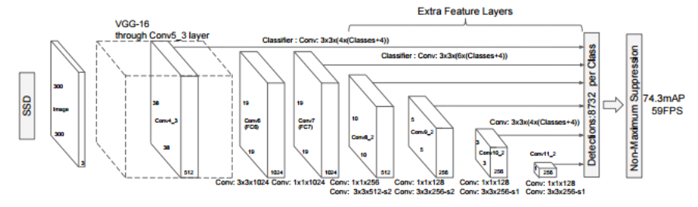
2
Progress
Learning Model
1. One-Stage Method
ex> YOLO, SSD
FAST!!

Slide 23
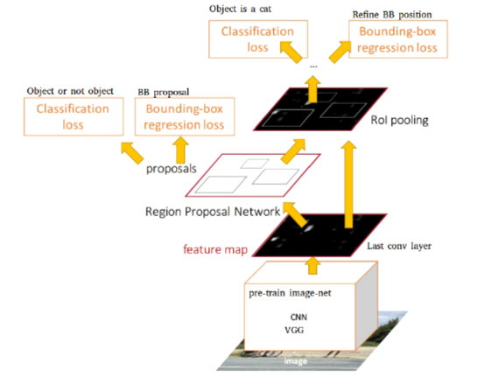
2
Progress
Learning Model
2. Two-Stage Method
High accuracy!!
ex> R-CNN, Fast R-CNN, Faster R-CNN

Slide 24
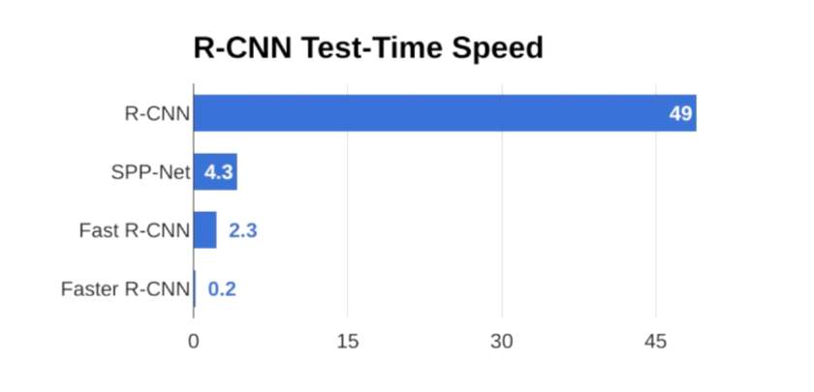
2
Progress
Learning Model
Time Comparison

Slide 25
2
Progress
Learning Model
Time Comparison

Slide 26
3.
Schedule

Slide 27
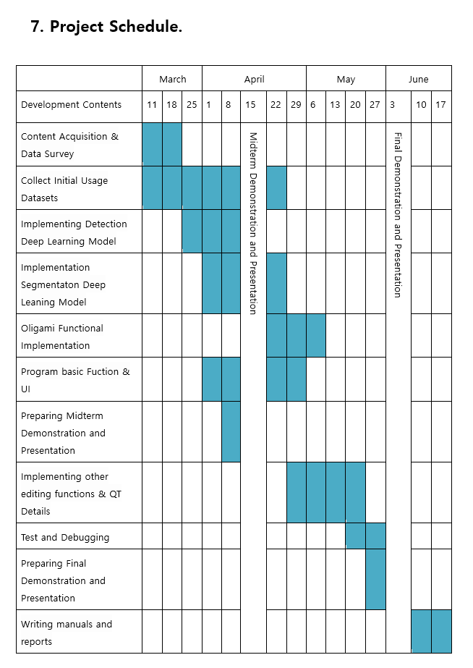
3
Total Schedule

Slide 28
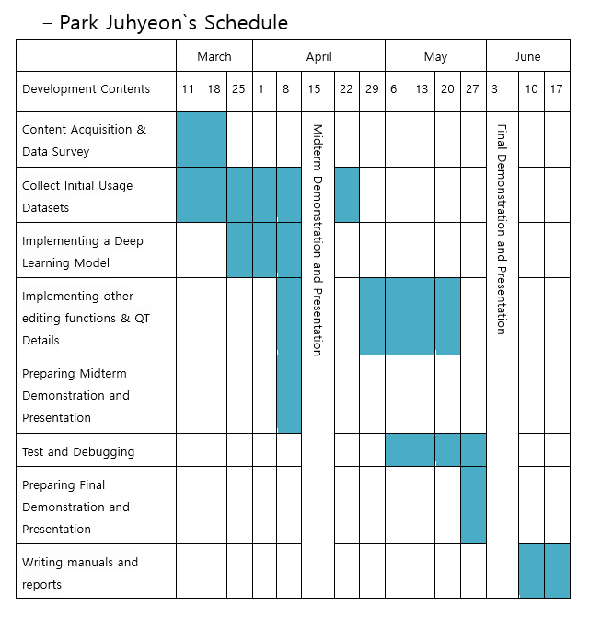
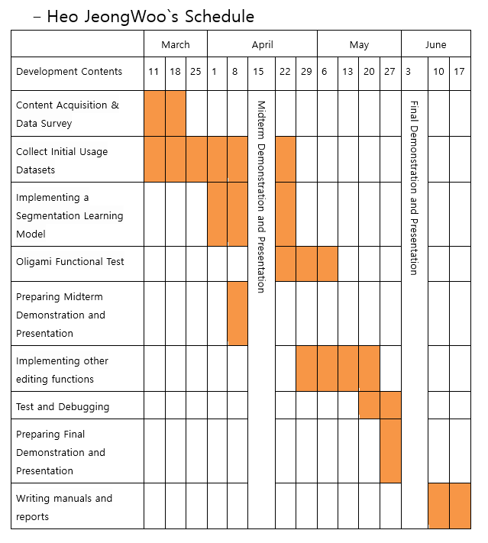
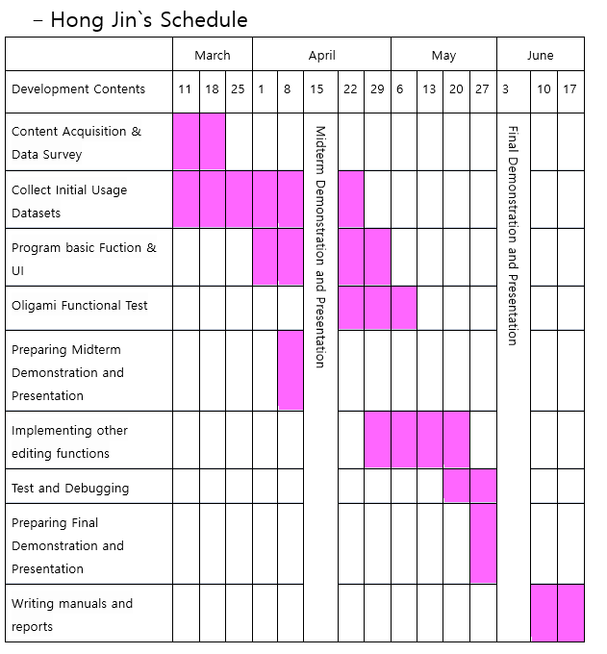
3
Schedule

Slide 29
4.
Q&A

